Slide 1
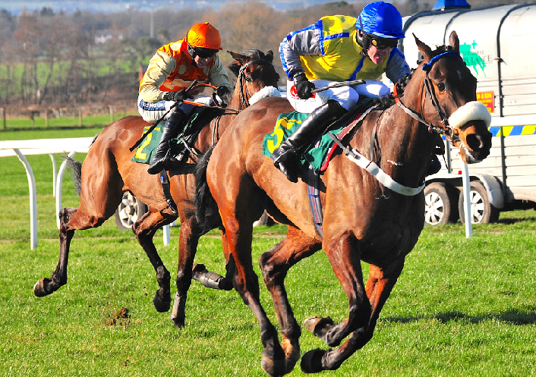
Isfield Village Hall
Race Night – 21st April 2018
Isfield Village Hall are hosting a first class Race Night on 21stApril 2018; doors open 7.30pm, first race 8pm. The price per person of £12.50 includes 8 races, a £1 bet on the first race, ploughman's supper and a glass of wine. Bring your own drinks. We have an experienced MC/compere, computerised tote system, race cards, advance sale of each of the horses in the first 7 races and an auction of the horses in the last race, selection of flat and hurdle races, all races shown on DVD. Book for this event by emailing info@isfieldvillagehall.org.uk.
www.isfieldvillagehall.org.uk
Station Road, Isfield, TN22 5XG

