Slide 1
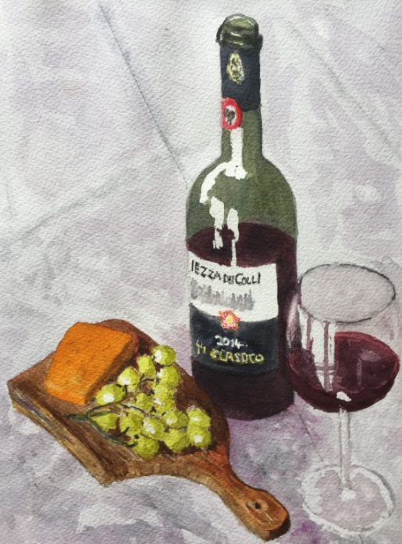
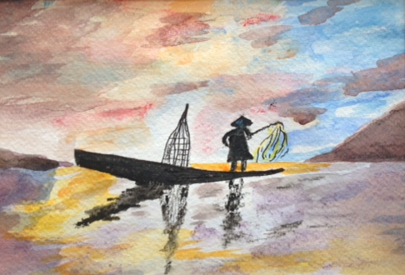
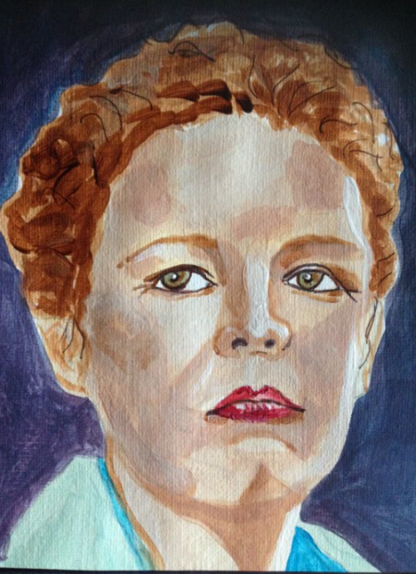
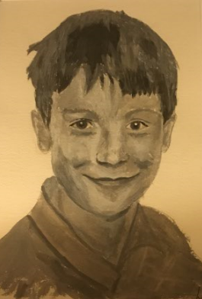
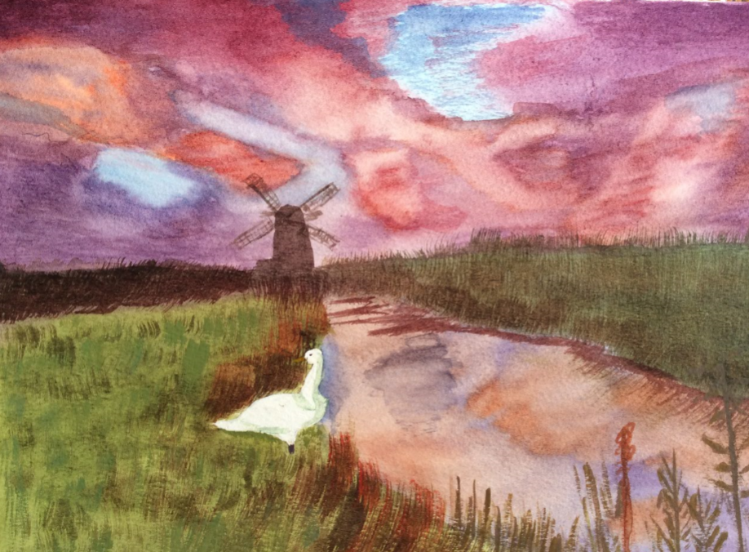
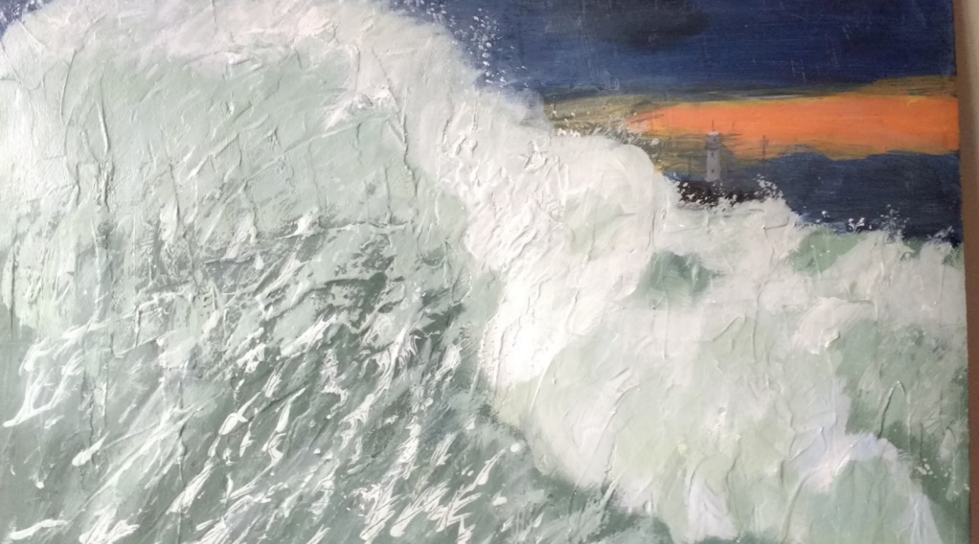
Isfield Art Group
Why not join Isfield Art Group?
Thursday 2pm to 4pm at Isfield Village Hall
This painting and drawing class is open to all levels from pure beginners to more experienced painters. We cover a wide range of topics from painting styles and techniques using watercolor, acrylics and pastels. Classes allow for personal tuition for everyone from a professional art tutor.
For more details contact Steve Pierce-Smith on steve@remingtons.co.uk or call 01797 253285.
www.isfieldvillagehall.org.uk
Station Road, Isfield, TN22 5XG

