Slide 1
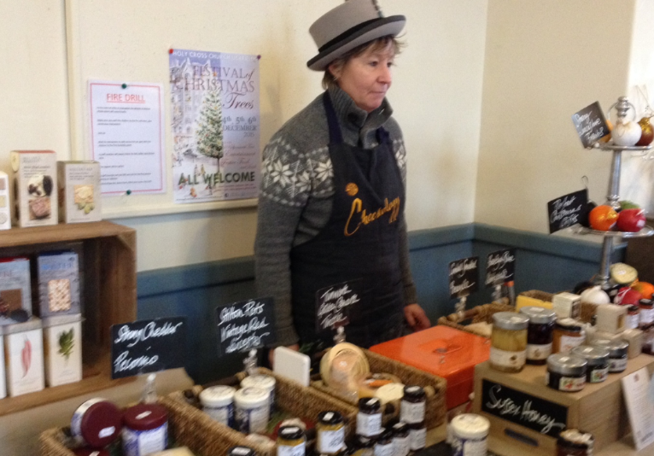
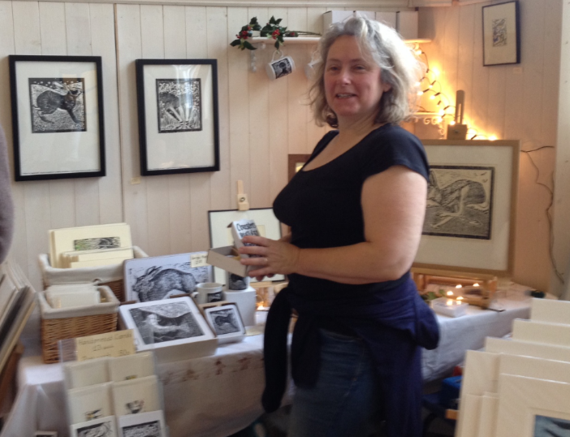
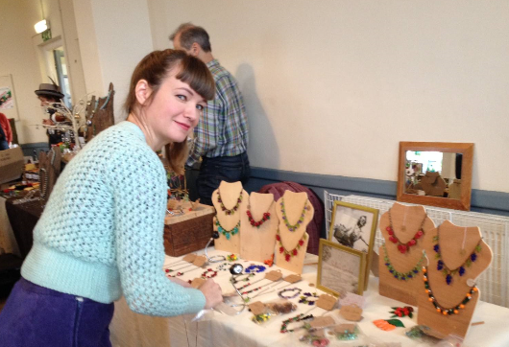
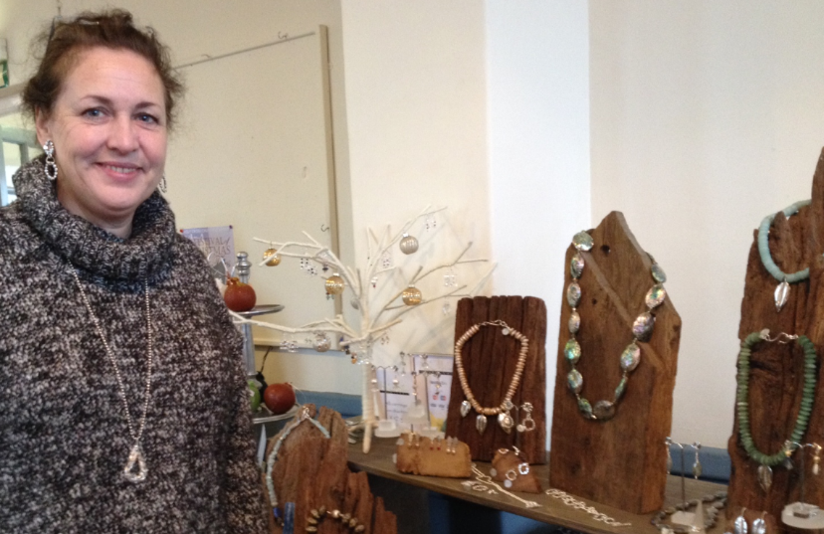
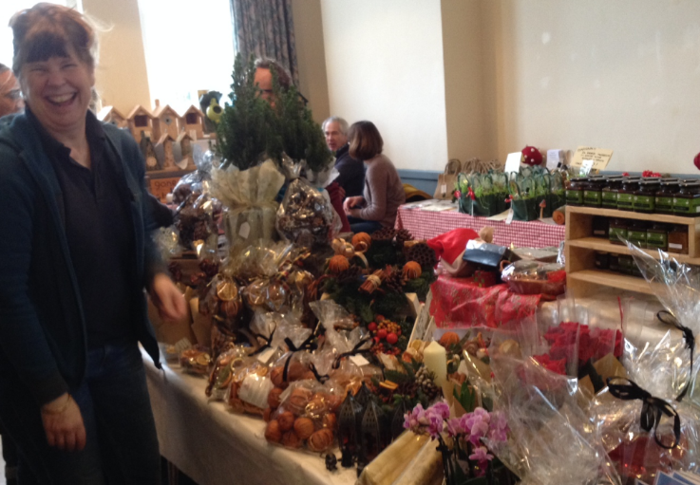
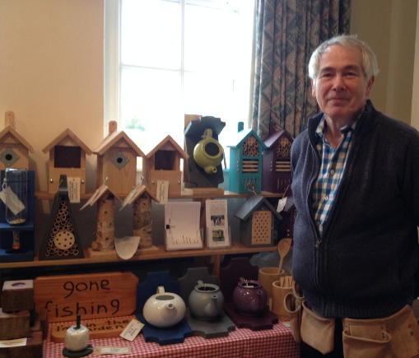
Isfield Village Hall
CHRISTMAS FAIR 26th Nov
Exciting stalls - Raffle - Prizes
Teas/Homemade cakes – Pizza Van
Entry FREE SUNDAY 26th November
(11am to 4pm)
Come and enjoy Isfield’s Frost Fair where local artists, craftspeople and suppliers will be offering wonderful Christmas gifts (e.g. Ceramics, knits, soft toys, artworks, prints, memo boards, stained glass, jewellery, cards, toiletries and scented soaps, chocolates, antique jewellery boxes and writing slopes etc.) and fabulous Christmas fare (wreaths, table centres, decorations, fruit vinegars, curry mixes and chilli sauces, cheeses, chutneys & jams, mustards, Christmas cakes & puddings, etc.).
www.isfieldvillagehall.org.uk
Station Road, Isfield, TN22 5XG

